Slide 1
CSIT 405
Web II: Advanced Web Development
Joseph Annan

Slide 2
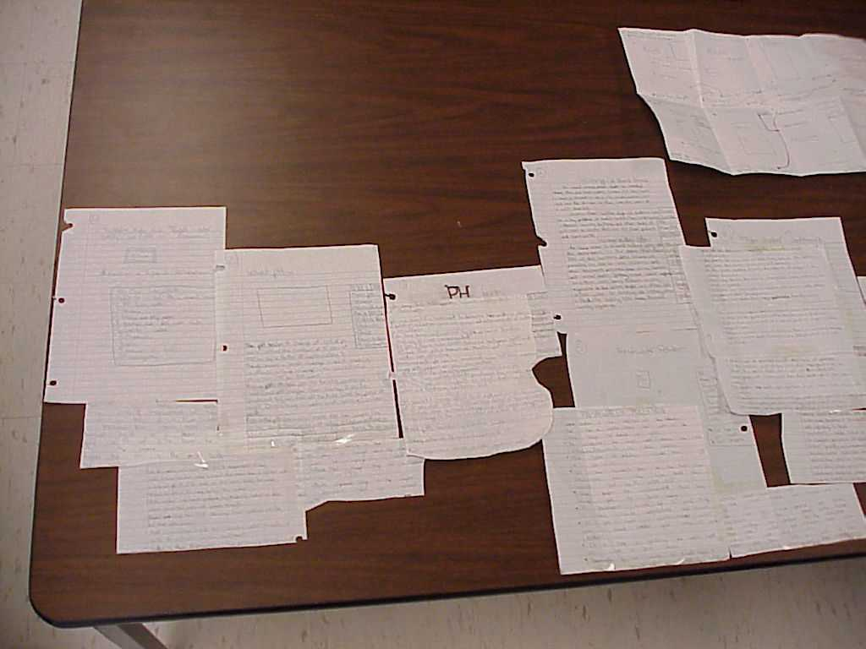
Brainstorming
Generate Ideas
Use your notes
Decide what you need and what you don’t need.
Do you need more info?

Slide 3
Structure
Based on your brainstorming session, make a plan.
Use your plan to design your presentation.
Decide what pictures or diagrams you will need and have a teammate create them.

Slide 4
Storyboard it
Provides an overall rough outline of what the presentation will look like, including:
Which topics go where,
the links,
and a conceptual idea of where your images go, and what the layout will look like.
You don't have to be able to draw to produce a storyboard. You need only sketch in the outlines.
Someone should be able to look at your storyboard and put together the same site you would have done.

Slide 5
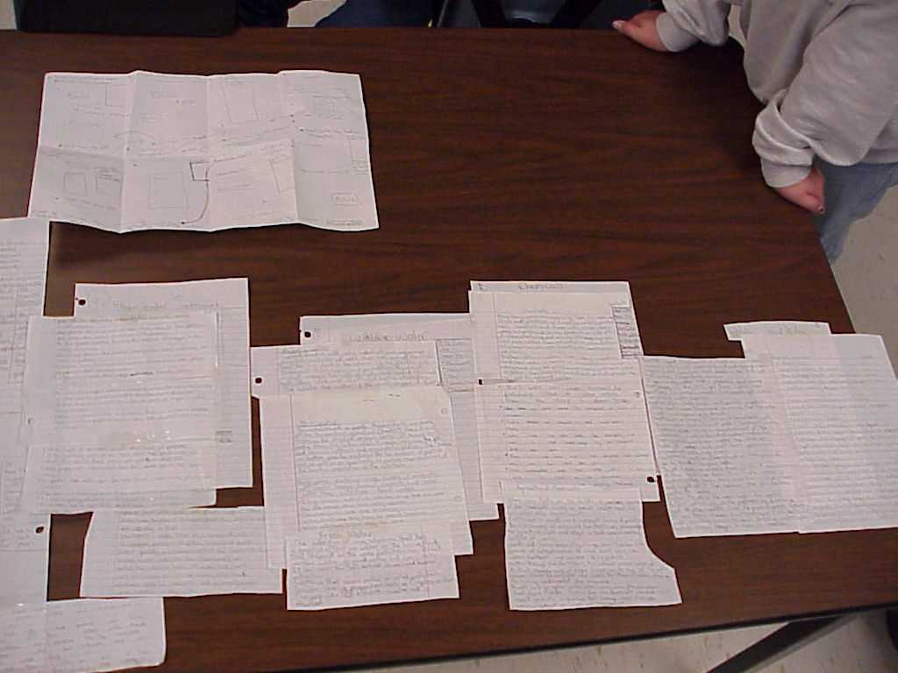

Slide 6
Storyboarding
All contents are in your own words
Includes all required elements as well as a few additions
Storyboards are easy to read and all elements are clearly written and labeled and drawn
Work on cooperatively your own with no interference from any authority

Slide 7
Wireframes

Slide 8
Design Tools
Wireframes are basic illustrations of the structure and components of a web page. This is generally the first step in the design process
Mockups generally focus on the visual design elements of the site. These are often very close or identical to the actual final site design and include all the graphics, typography, and other page elements. Mockups are generally just image files.
Prototypes are semi-functional webpage layouts of a mockup/comp that serves to give a higher-fidelity preview of the actual site being built. Prototypes will have the user interface and is usually constructed using HTML/CSS . This stage precedes programming the business logic of the site.
From: http://sixrevisions.com/user-interface/website-wireframing/

Slide 9
What is a wireframe?
Low-fidelity visual representation, may be called a skeleton or blueprint
Some debate how polished wireframe should be
Includes basic page layout
Includes navigational scheme of the site’s pages
May include:
headers, footers, content areas, sidebars
dynamic widgets, search box, graphics, links

Slide 10
Why wireframe?
Wireframes allow project team members and clients to do such things as:
Test and refine navigation
See how content lays out on the page
Study and rapidly refine the user interface design of web forms and interactive elements
Evaluate overall effectiveness of the page layout against usability best practices
Determine web development/programming requirements

Slide 11
Reasons to Use a Wireframe
Wireframes Make Design Changes More Efficient
Client can view overall layout
Wireframes Make Site Navigation Designs Better
Can test and refine without having to reprogram
Wireframes Make Content Development More Design Friendly
Wireframes Can Improve Content
makes use of design elements such as readable fonts, properly sized fonts, numbered lists, bullets and well-positioned subheads.
Wireframes Can Improve User Interface Copy
What label should be used for the call to action button?
Wireframes Help Clients Help Their Cause
It is far easier and less costly and puts far less strain on the relationship. Helps to address issues in this early phase of the project than later on
Wireframes Help Web Developers
From: http://sixrevisions.com/user-interface/wireframing-benefits/

Slide 12
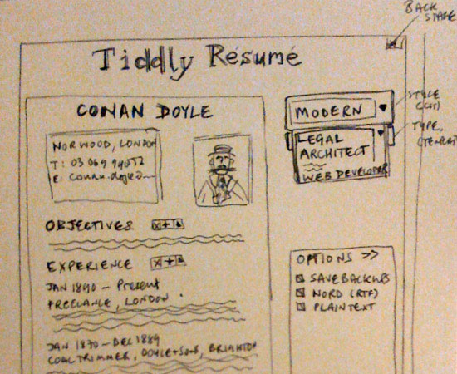
Rough Sketch

Slide 13
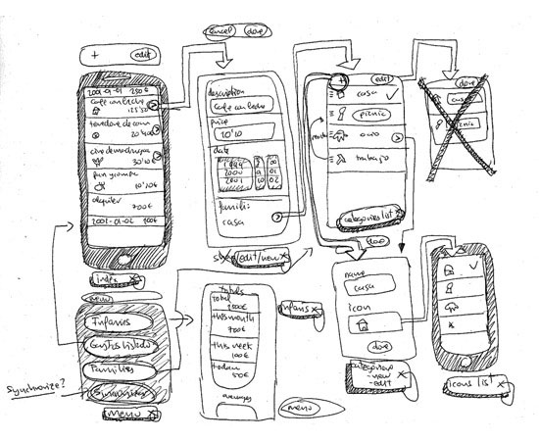
Rough Sketch

